Slide 1
Java Enterprise System
Solving computing problems in a
Distributed
Multi-tier
Server-centric environment.

Slide 2
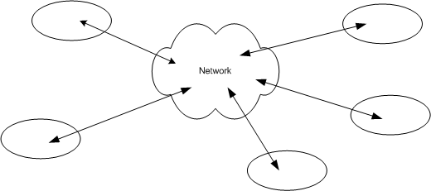
Distributed
Means that the components that make up our system could be living on different machines and communicate through the network
Components must be able to find each other and to communicate effectively

Slide 3
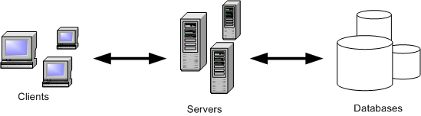
Multi-tier
In an enterprise environment we can identify components having very different roles (client, server, database) and different requirements

Slide 4
Server centric
Balancing workload
The server performs the operations needed to solve our particular problem (business logic).

Slide 5
Separation Of Concerns(SOC)
Separation of Concerns is the process of separating a software into distinct features that overlap in functionality as little as possible.
Modularity principles to be followed
Low Coupling
separating unrelated parts of the code base as much as possible.
High Cohesion
keeping parts of a code base that are related to each other in a single place.
Approaches
Multi-tier or Vertical Partitioning
Multi-layer or Horizontal Partitioning

Slide 6
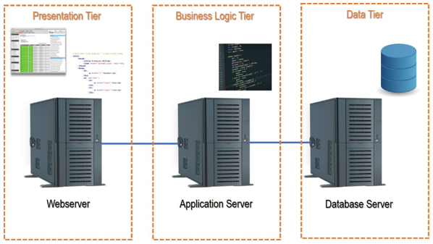
Vertical Separation or Tiering Architecture
Applications divided into modules of functionality.
Physical structuring the Applications
Each tier is replaceable Components with full functionality
Pros
Portability
Change management
Effective Resource Management
Cons
Complexity increased
Performance decreased
Uncertainty of Interoperability

Slide 7
Horizontal or Layering Architecture
Logical Separation of Applications
Hierarchical Organizations of Applications with Partial functionality
Design with increasing level of abstraction
Pros
Support for Enhancement
Reuse
Handling of Abstraction with various levels
Cons
Topological Constraints
Performance reduced due to layers
Difficult to implement

Slide 8
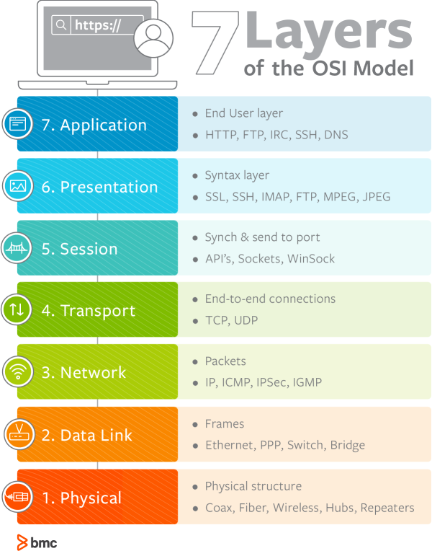

Slide 9
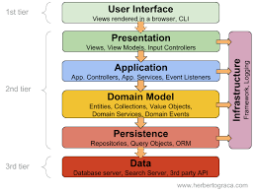

Slide 10
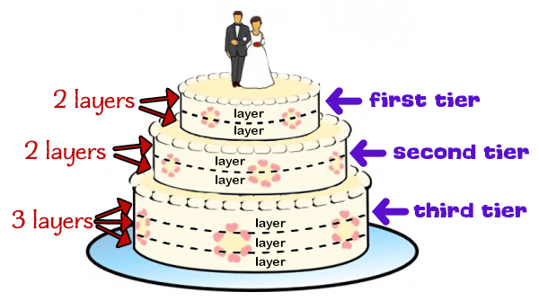
Layers vs Tiers
N-Tier refers to the actual n system components of your application.
On the other hand, N-Layers refer to the internal architecture of your component.

Slide 11
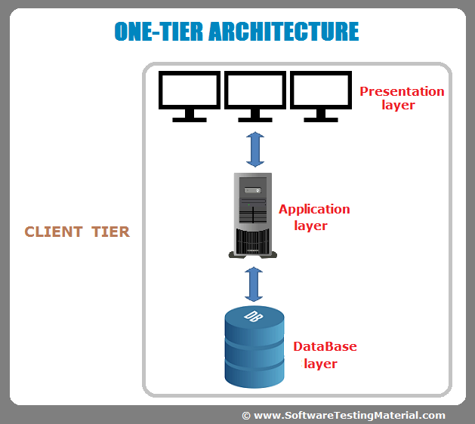

Slide 12
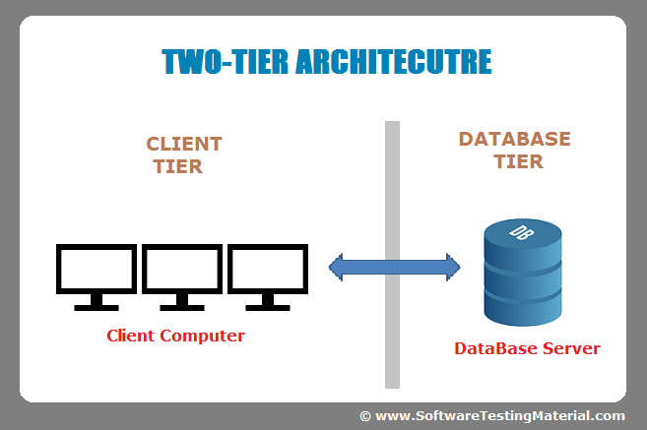
Presentation and Application layers
Database layer

Slide 13
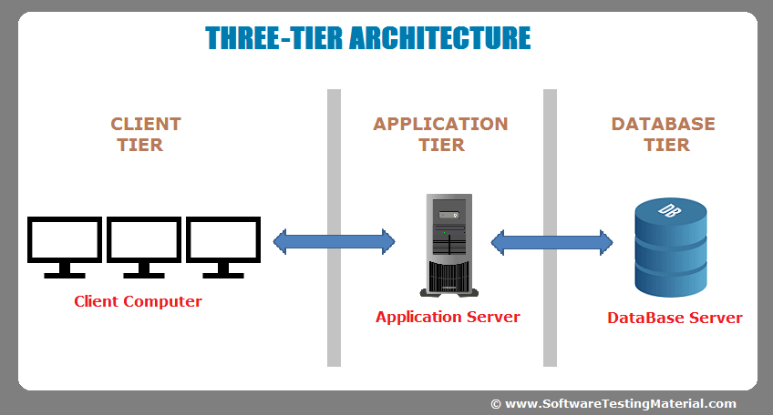
Presentation layer
Application layer
Database layer

Slide 14
Common 3-tier architecture
Client
Interfaces with the user
Server
Implements Business Logic
Implements Middleware
Database
Persistently stores data
Retrieves stored data

Slide 15
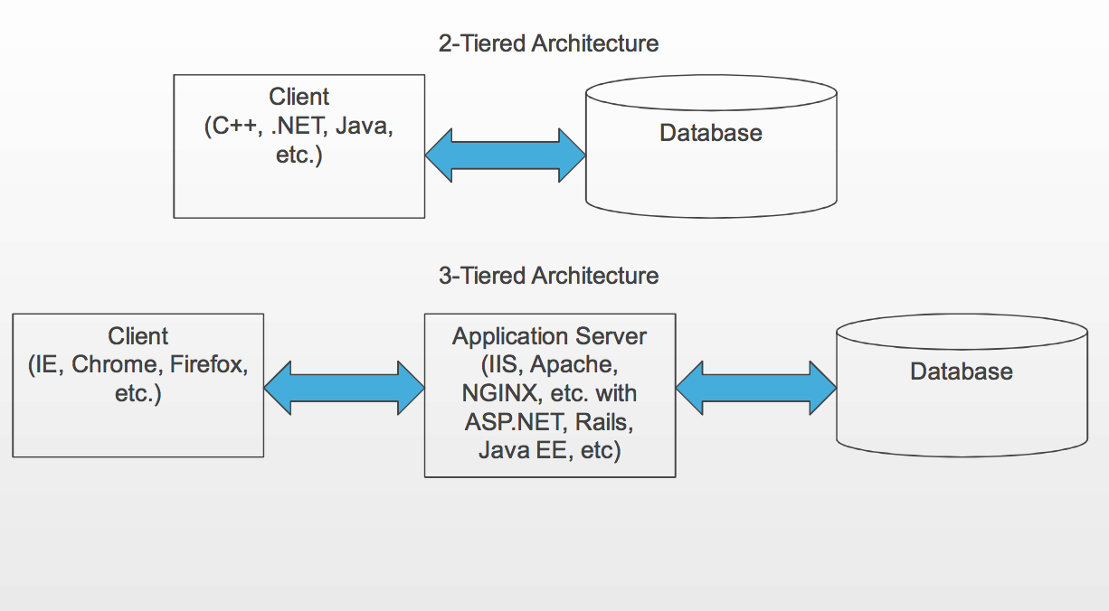

Slide 16
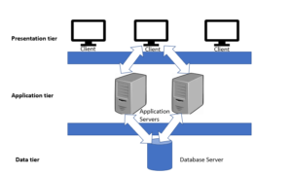
N-Tier application(Distributed application)
similar to three tier architecture but number of application servers are increased and represented in individual tiers in order to distributed the business logic so that the logic will be distributed.
Increased number of Application servers

Slide 17
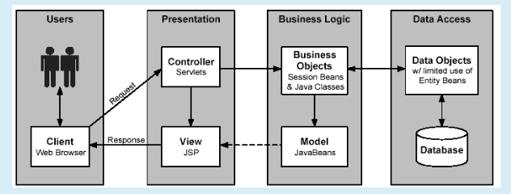
N-Tier or Multi-tier Architecture (Unlimited Tiers)
Pros:
Powerful Architecture
Improved Maintainability
Provide Consistency
Inter- operability
Scalability
Division of Work
Efficient Change Management
Cons
Software is More Complex
Complicated Design and Model
Performance Risk
How to achieve Reliability

Slide 18
Above ALL in J2EE

Slide 19
What is J2EE (or JEE)
Short for Java 2 Platform Enterprise Edition.
J2EE is a platform-independent, Java-centric environment from Sun/Oracle for developing, building and deploying Web-based enterprise applications online.
The J2EE platform consists of a set of services, APIs, and protocols that provide the functionality for developing multi-tiered, Web-based applications.

Slide 20
History
The platform was known as Java 2 Platform,( WORA)
Sun micro system🡪 oracle corporation
J2EE 1.2 (December 12, 1999)
J2EE 1.3 (September 24, 2001)
J2EE 1.4 (November 11, 2003)
Java EE 5 (May 11, 2006)
Java EE 6 (December 10, 2009)
Java EE 7 (May 28, 2013)
Java EE 8 (August 31, 2017)
Jakarta EE 8 (September 10, 2019)
Jakarta EE 9 (November 22 2020)

Slide 21
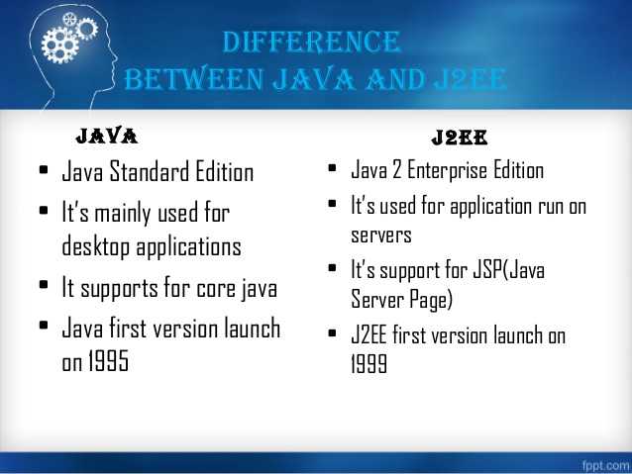

Slide 22
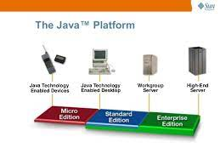
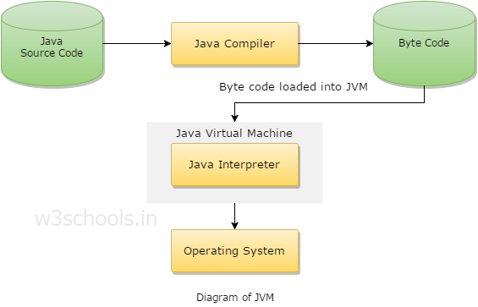
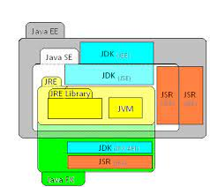

Slide 23
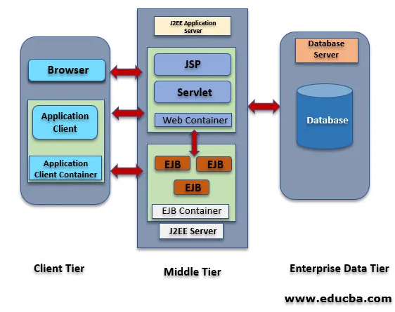

Slide 24
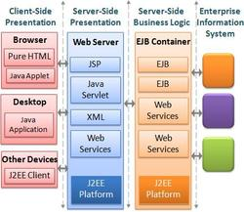

Slide 25
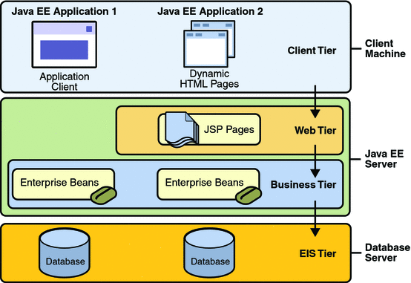
J2EE

Slide 26
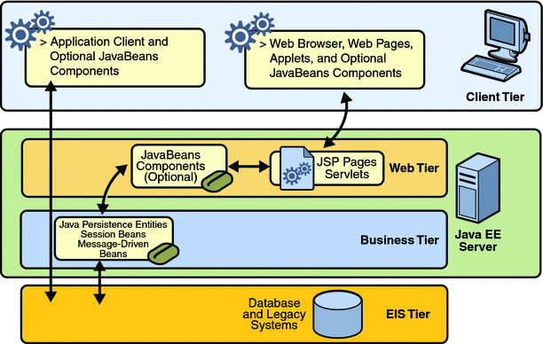

Slide 27
Client tier
Act as a user interface.
Get the input from user and convert as a request and send to middle tier.
It translates server response to text and presented to the user .

Slide 28
Middle tier
Consist of one or more tiers
It process the request, generates the response and give it to the client tier
Application server or web server
Various container for processing the request
Web container(web tier)
Used for deploying web application
Provide internet functionality for J2EE application
Components (Servlets, JSP)
EJB container(EJB tier)
Consists of Business logic of application(EJB)
Deploy business application

Slide 29
EIS Tier
Provide the Data bases for application, Back end for an application

Slide 30
J2EE Development Lifecycle
Develop components for
Presentation (JSP, HTML)
Persistence (Entities)
Business Logic (EJBs)
Configure/Prepare deployment descriptors(WSDL)
Build Components in packages (JARs, WARs, EARs)
Deploy packages on Container (J2EE Server)

Slide 31
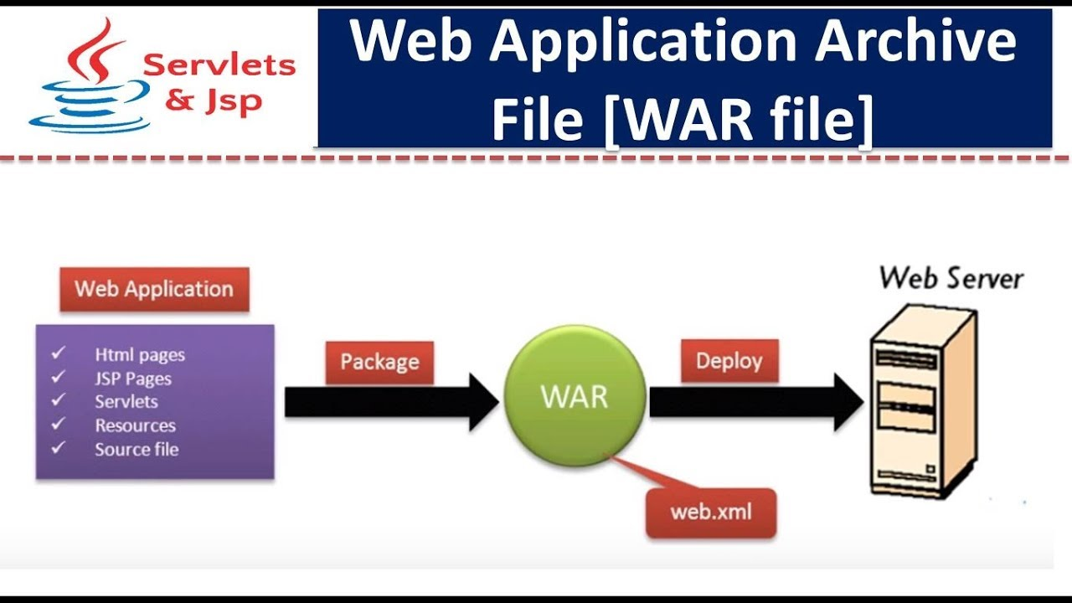

Slide 32
